Slide 1
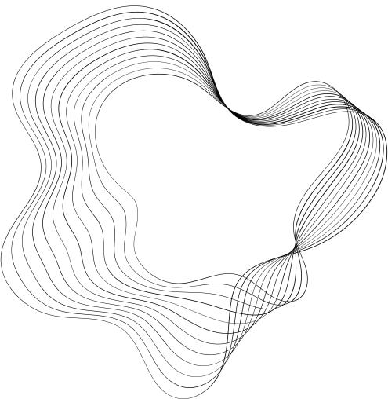

TITLE: TOWARDS NEXT-GENERATION LLM-BASED RECOMMENDER SYSTEMS
BY: MANSI VEKARIYA
DEC 4,2024
Notes:
Hello everyone, my name is [Your Name], and today I will be presenting a detailed overview of the paper Towards Next-Generation LLM-Based Recommender Systems. This survey introduces a novel taxonomy and explores the potential of Large Language Models to transform recommender systems. Let’s dive in."

Slide 2

INTRODUCTION
Key Points:
Recommender systems are integral for digital experiences.
Traditional methods lack deep semantic understanding.
Large Language Models (LLMs) bring a paradigm shift.
Contributions of the survey:
A novel three-tier taxonomy for LLM-based systems.
Addressing the gap between academia and industry.
Challenges and opportunities in deploying LLMs.
Notes:
Recommender systems play a crucial role in digital platforms, from e-commerce to media streaming. Traditional systems rely heavily on embeddings and ranking mechanisms but often lack the depth of semantic understanding. Large Language Models, or LLMs, address this gap by adding reasoning and contextual capabilities.
This survey introduces a three-tier taxonomy and highlights the challenges and opportunities for deploying LLMs in real-world systems.

Slide 3
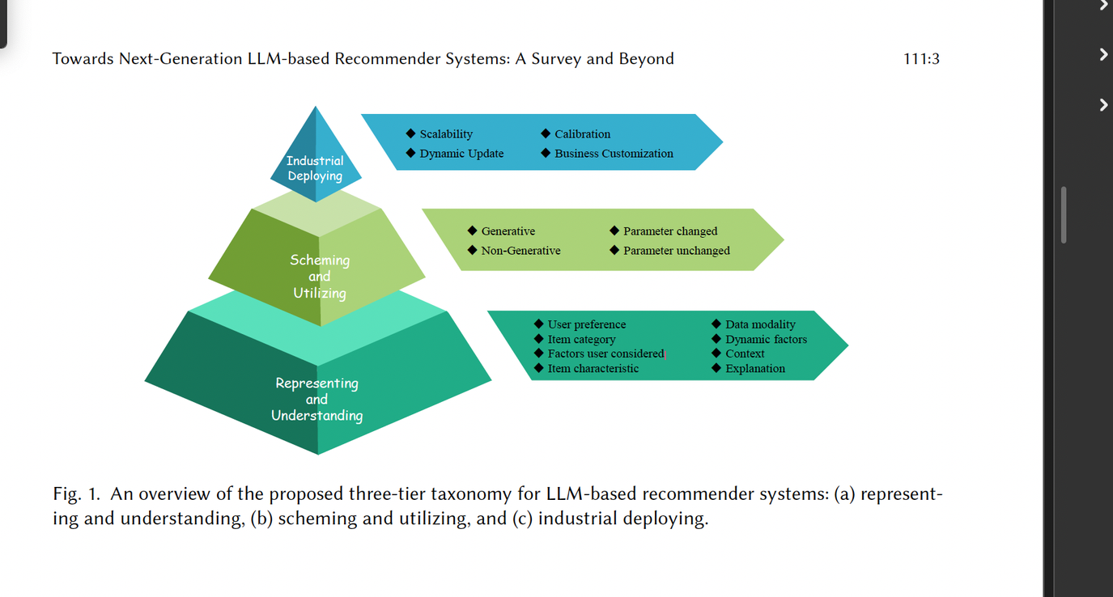
THREE-TIER TAXONOMY
Representing and Understanding: Creating user/item embeddings enriched with semantic context.
Scheming and Utilizing: Adopting LLM techniques for improved ranking and direct recommendations.
Industrial Deployment: Real-world scaling and customization.
Notes:
Three-Tier Taxonomy "Here is the three-tier taxonomy proposed in the paper. At the bottom, we have Representing and Understanding, focusing on embeddings and data modalities. The middle tier, Scheming and Utilizing, includes the techniques used to process these embeddings for recommendation tasks. Finally, the top tier, Industrial Deployment, deals with scaling these solutions in real-world applications

Slide 4

REPRESENTING AND UNDERSTANDING
Key Points:
Uni-Modality:
Example: Text-only or ID-based inputs.
Techniques: Dynamic reflection, graph modeling.
Multi-Modality:
Example: Text, images, audio combined for richer context.
Techniques: Cross-reflection prompting, multimodal summarization.
Notes:
In the Representing and Understanding tier, the focus is on creating embeddings.
Uni-Modality methods use single data types like text or user-item interactions.
Multi-Modality approaches combine data from diverse sources, such as text and images, for a richer understanding.
This is essential for dynamic and context-aware recommendations."

Slide 5
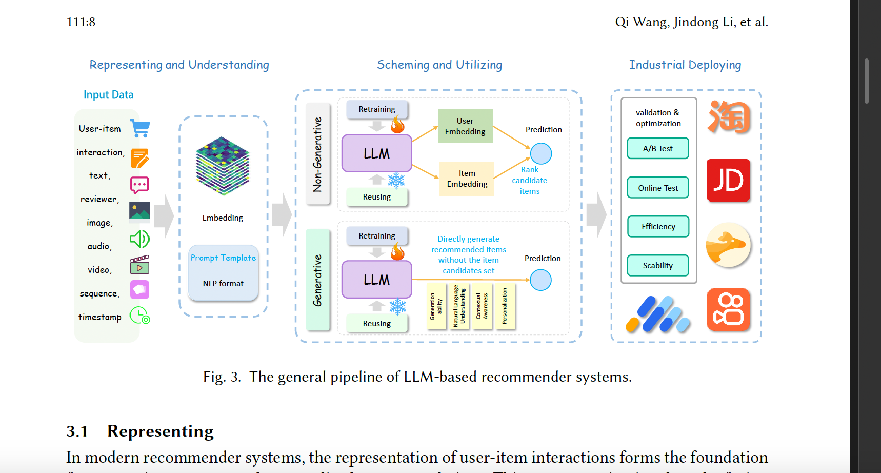
Notes:
This figure outlines the general pipeline for LLM-based recommendation systems. Input data, such as user interactions or media, is transformed into embeddings. Non-Generative approaches focus on ranking candidates, while Generative methods directly generate recommendations.

Slide 6
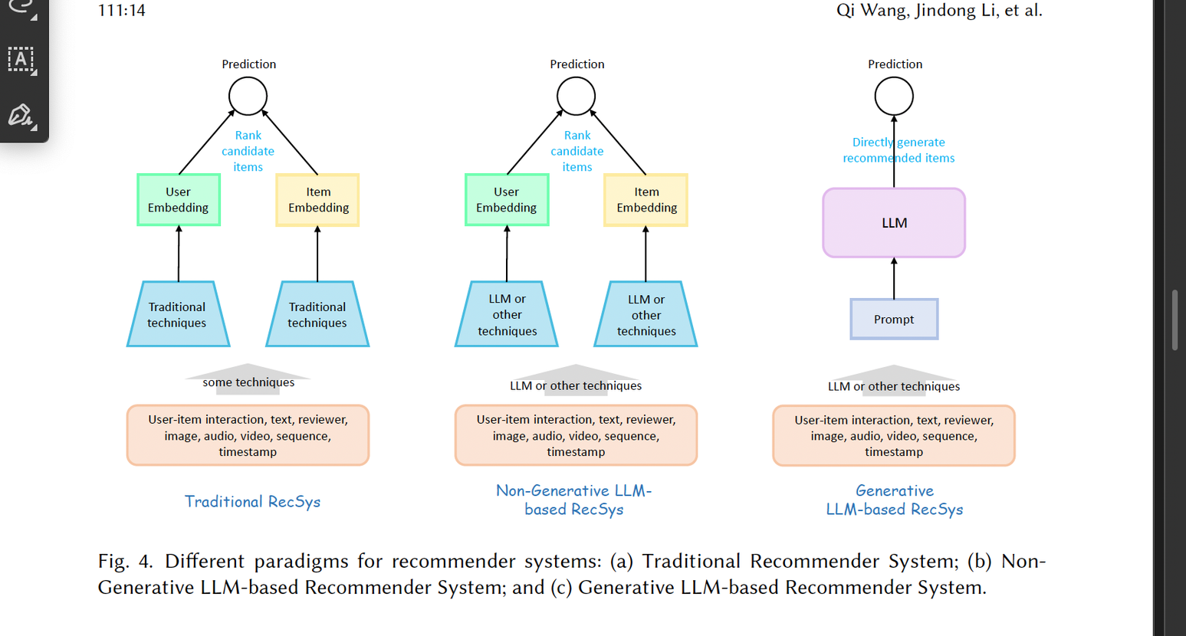
SCHEMING AND UTILIZING
This tier focuses on how LLMs can be employed:
Non-Generative approaches like Fine-Tuning or LoRA enhance feature extraction and ranking tasks.
Generative approaches directly produce recommendations using textual generation, as seen in frameworks like IDGenRec.
These methods redefine how recommendations are formulated.
Notes:
This comparison shows the evolution of recommender systems. Traditional systems rely on handcrafted features. Non-Generative LLM-based systems improve ranking using embeddings, while Generative systems leverage LLMs to create recommendations directly."

Slide 7
INDUSTRIAL DEPLOYMENT
Industrial deployment of LLMs presents unique challenges:
Scalability: Handling real-time recommendations for millions of users.
Privacy: Safeguarding sensitive data while ensuring personalization.
However, it also offers opportunities, such as tailored solutions for industries like e-commerce and education."
Notes:
industrial deployment of LLMs presents unique challenges:
Scalability: Handling real-time recommendations for millions of users.
Privacy: Safeguarding sensitive data while ensuring personalization.
However, it also offers opportunities, such as tailored solutions for industries like e-commerce and education

Slide 8
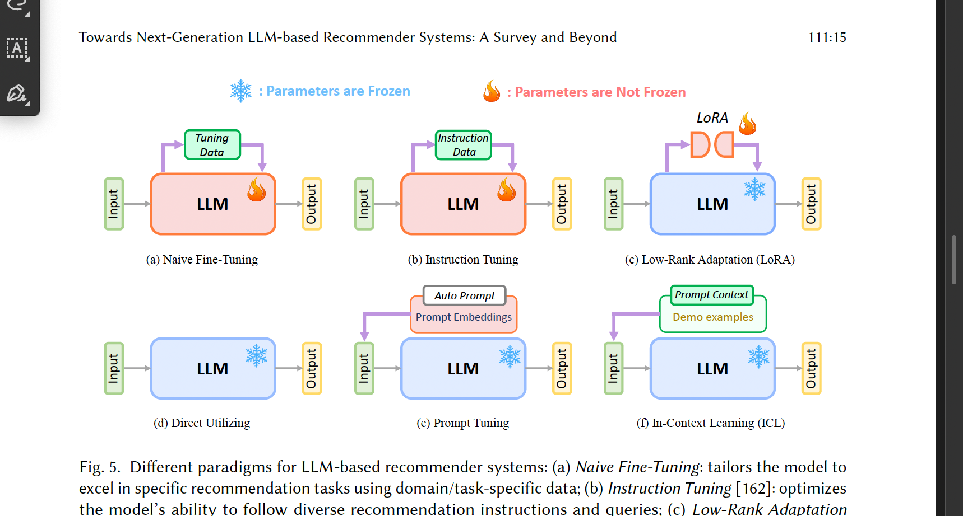
KEY TECHNIQUES
Let’s discuss three impactful techniques:
Fine-Tuning aligns LLMs with specific tasks.
Instruction Tuning converts task data into natural language instructions for better performance.
LoRA is a resource-efficient way to adapt LLMs for specialized applications.
Notes:
This diagram shows different techniques for adapting LLMs to recommendation tasks. For example:
Fine-Tuning adjusts all parameters to improve performance.
LoRA provides a lightweight alternative for resource constraints.
Prompt Tuning uses input examples for task-specific performance

Slide 9
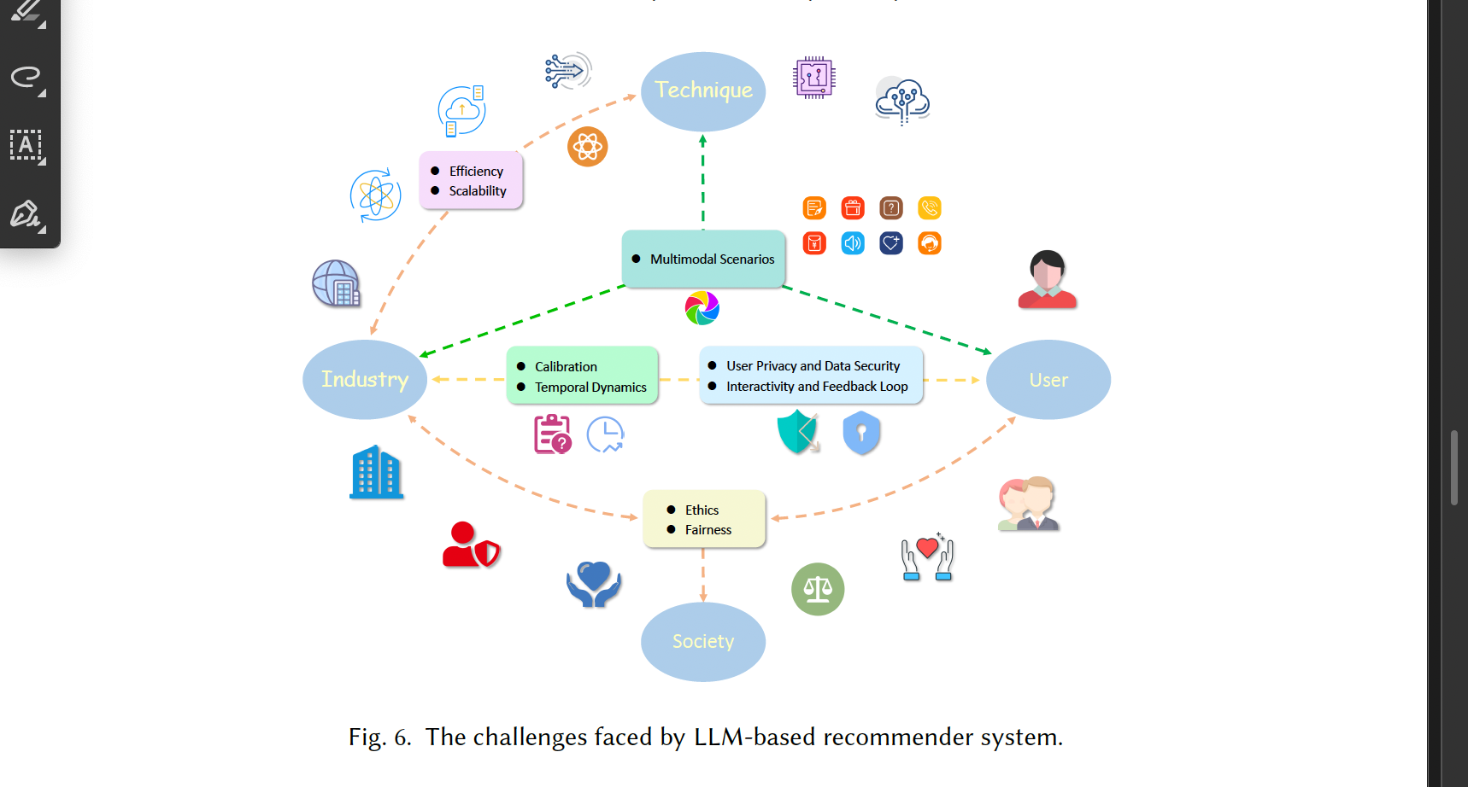
CHALLENGES AND OPPORTUNITIES
"The field faces ethical challenges, such as mitigating bias and ensuring fairness. However, opportunities abound, including lightweight LLMs for on-device applications and explainable AI for better transparency."
Notes:
This mind map highlights the challenges faced by LLM-based systems:
Scalability and efficiency are critical for industrial deployment.
Privacy and fairness remain key ethical concerns. However, there are opportunities to innovate with multimodal scenarios and explainable AI."

Slide 10

CONCLUSION
To conclude, LLMs are transforming recommender systems by improving reasoning, personalization, and scalability. The proposed taxonomy provides a roadmap for aligning research and industrial needs. With collaboration, we can address the challenges and unlock the full potential of LLMs.
STUDENT ID:
016996291
Notes:
To conclude, LLMs are transforming recommender systems by improving reasoning, personalization, and scalability. The proposed taxonomy provides a roadmap for aligning research and industrial needs. With collaboration, we can address the challenges and unlock the full potential of LLMs."

